Slide 1

Before Starting…
If you want to see our PPT, codes or plots,
QR code or https://github.com/kdh-yu/group11_dsp
Presentation>ppt

Slide 2

Manufacturers should reduce production of Non-Recyclable Plastics
Our approach to the resource problem
Group 11: Kim Dohoon (2022094093); Yun Donghyun (2022084339); Raudhah Radzif (2022011703)

Slide 3
Contents
01
02
Problem
Definition
Why Focus
On Plastic?
03
04
Current Systems
: Limitations
Our Suggestions

Slide 4
What is the Resource Problem?
Supply is not enough to meet growing demand
“The global resource problem is that people consume without any limitation, and deplete the reserves of natural elements of the planetary ecosystem, the components of organic and non-organic life, and the conditions for the existence of … people and society.”
Source: Planetary Project
literature review

Slide 5
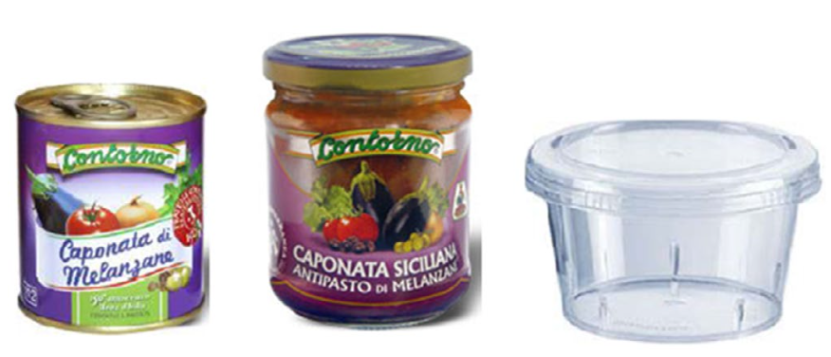
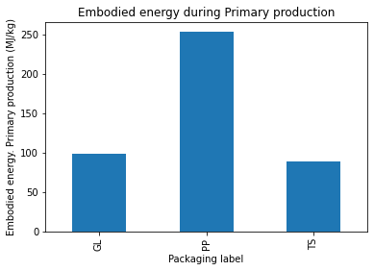
Why Plastic?
Embodied energy: a calculation of all the energy that is used to produce a material or product, including mining, manufacture and transport.
(yourhome.au)
Source: Ingarao et al. (2017)

Slide 6
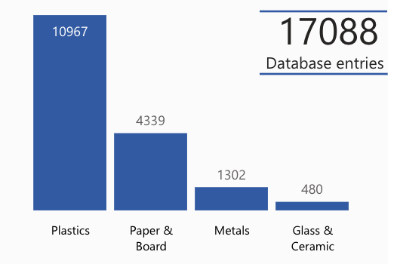
Why Plastic?
Source: Food Packaging Forum
Source: Ingarao, et al. (2017).
Plastic is a significant consumer of energy in its production

Slide 7
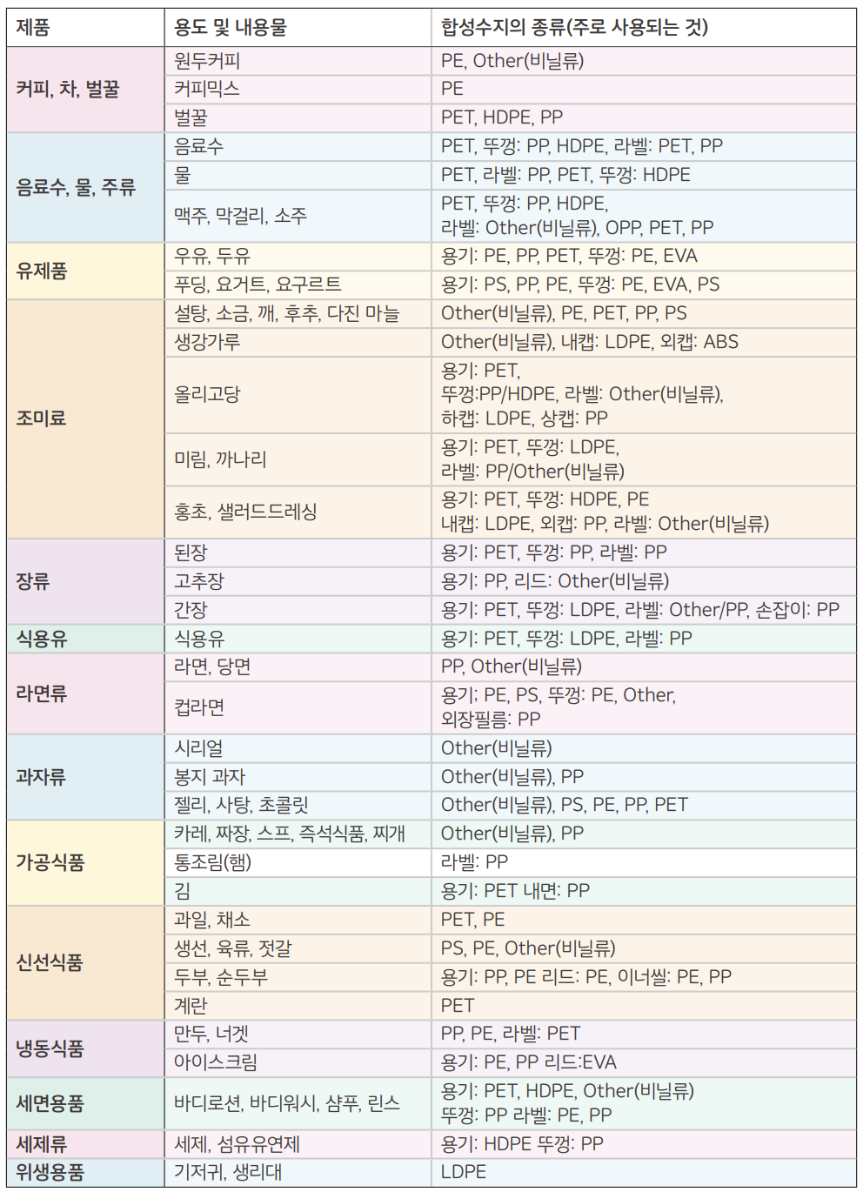
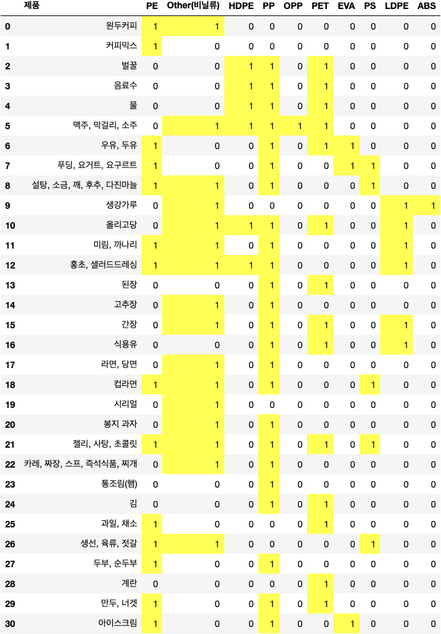
Why can’t we just recycle all plastic?
김 이서. (2019, December). 플라스틱 대한민국 - 일회용의 유혹. Greenpeace Korea | 그린피스. Retrieved from https://www.greenpeace.org/

Slide 8
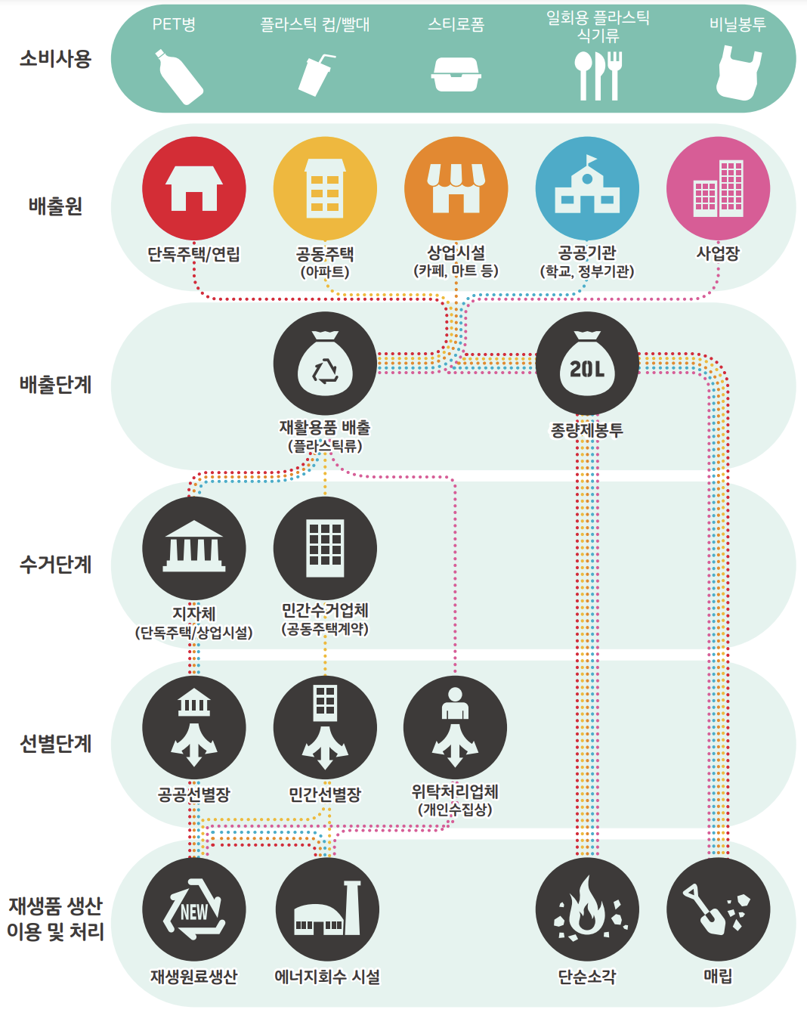
Trash disposal process
김 이서. (2019, December). 플라스틱 대한민국 - 일회용의 유혹. Greenpeace Korea | 그린피스. Retrieved from https://www.greenpeace.org/

Slide 9
If they are not disposed separately…
김 이서. (2019, December). 플라스틱 대한민국 - 일회용의 유혹. Greenpeace Korea | 그린피스. Retrieved from https://www.greenpeace.org/

Slide 10
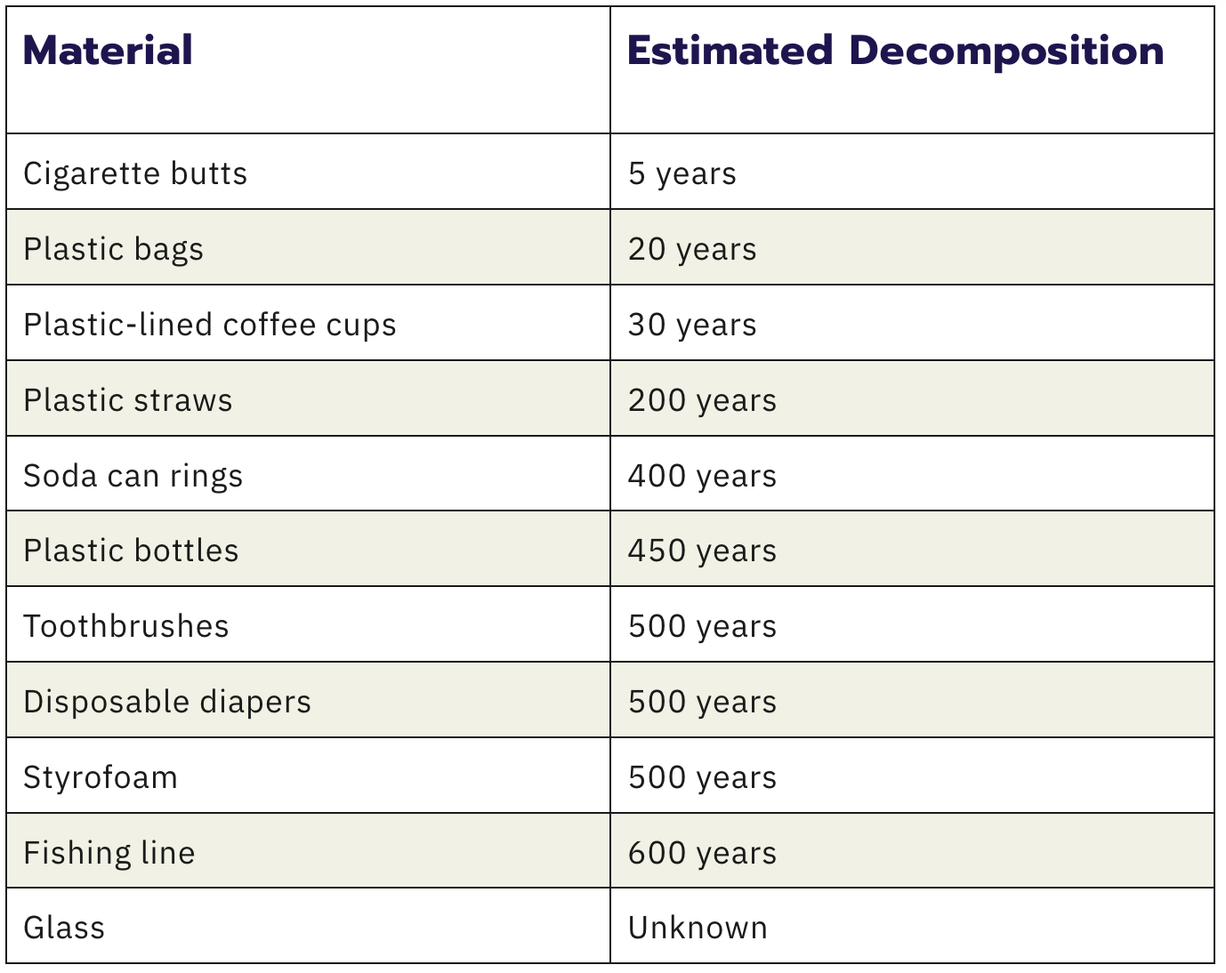
If they are buried…
How long does it take for plastic to decompose? Chariot Energy. (2022, October 20). Retrieved December 14, 2022, from https://chariotenergy.com/blog/how-long-until-plastic-decomposes/

Slide 11
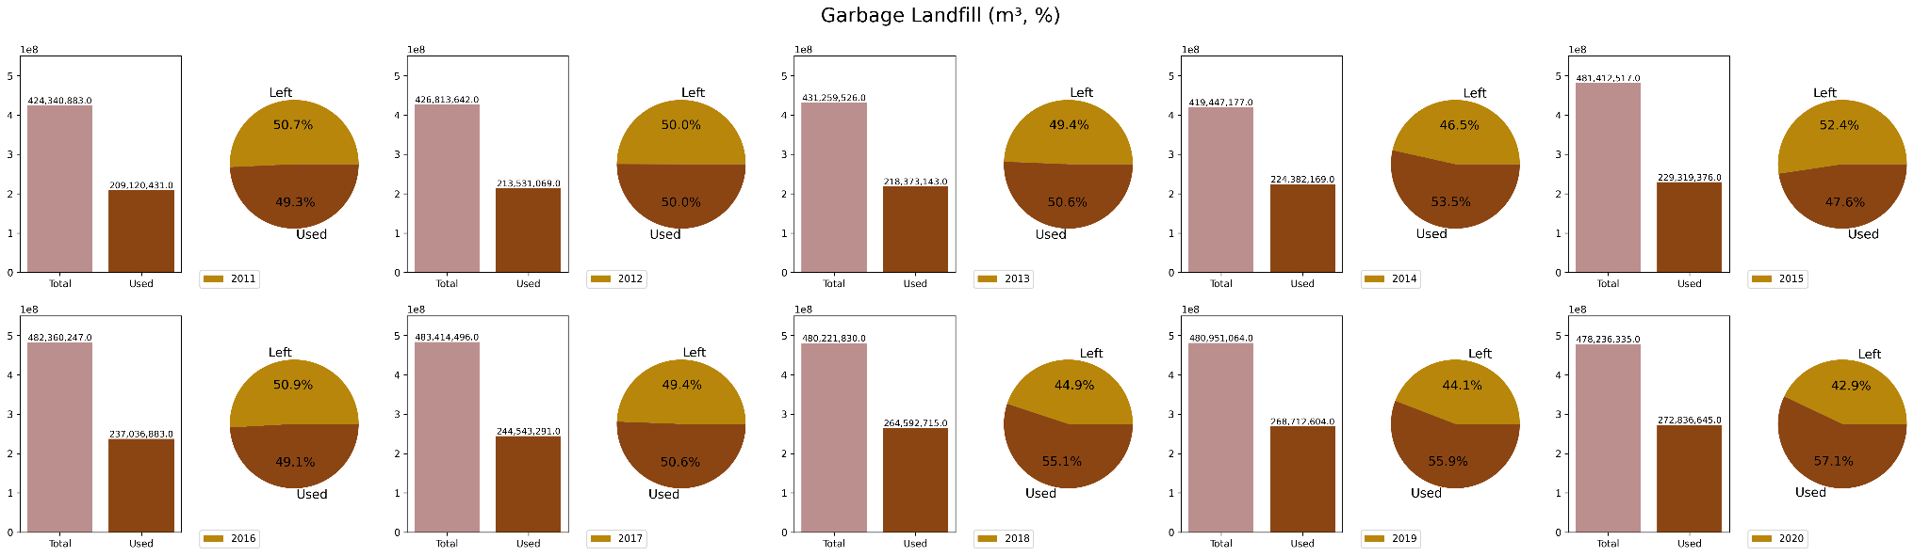
If they are buried…
환경부,「전국폐기물발생및처리현황」, 2020, 2022.12.14, 지방자치단체 폐기물 처리시설 현황_매립시설

Slide 12
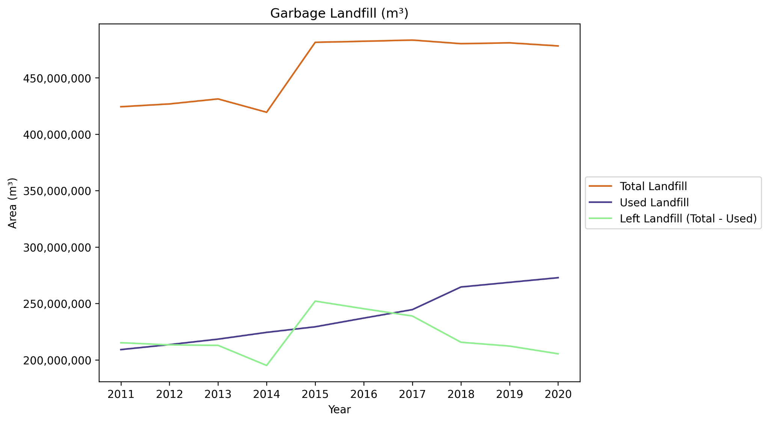
Garbage Landfills (Korea nationwide)

Slide 13
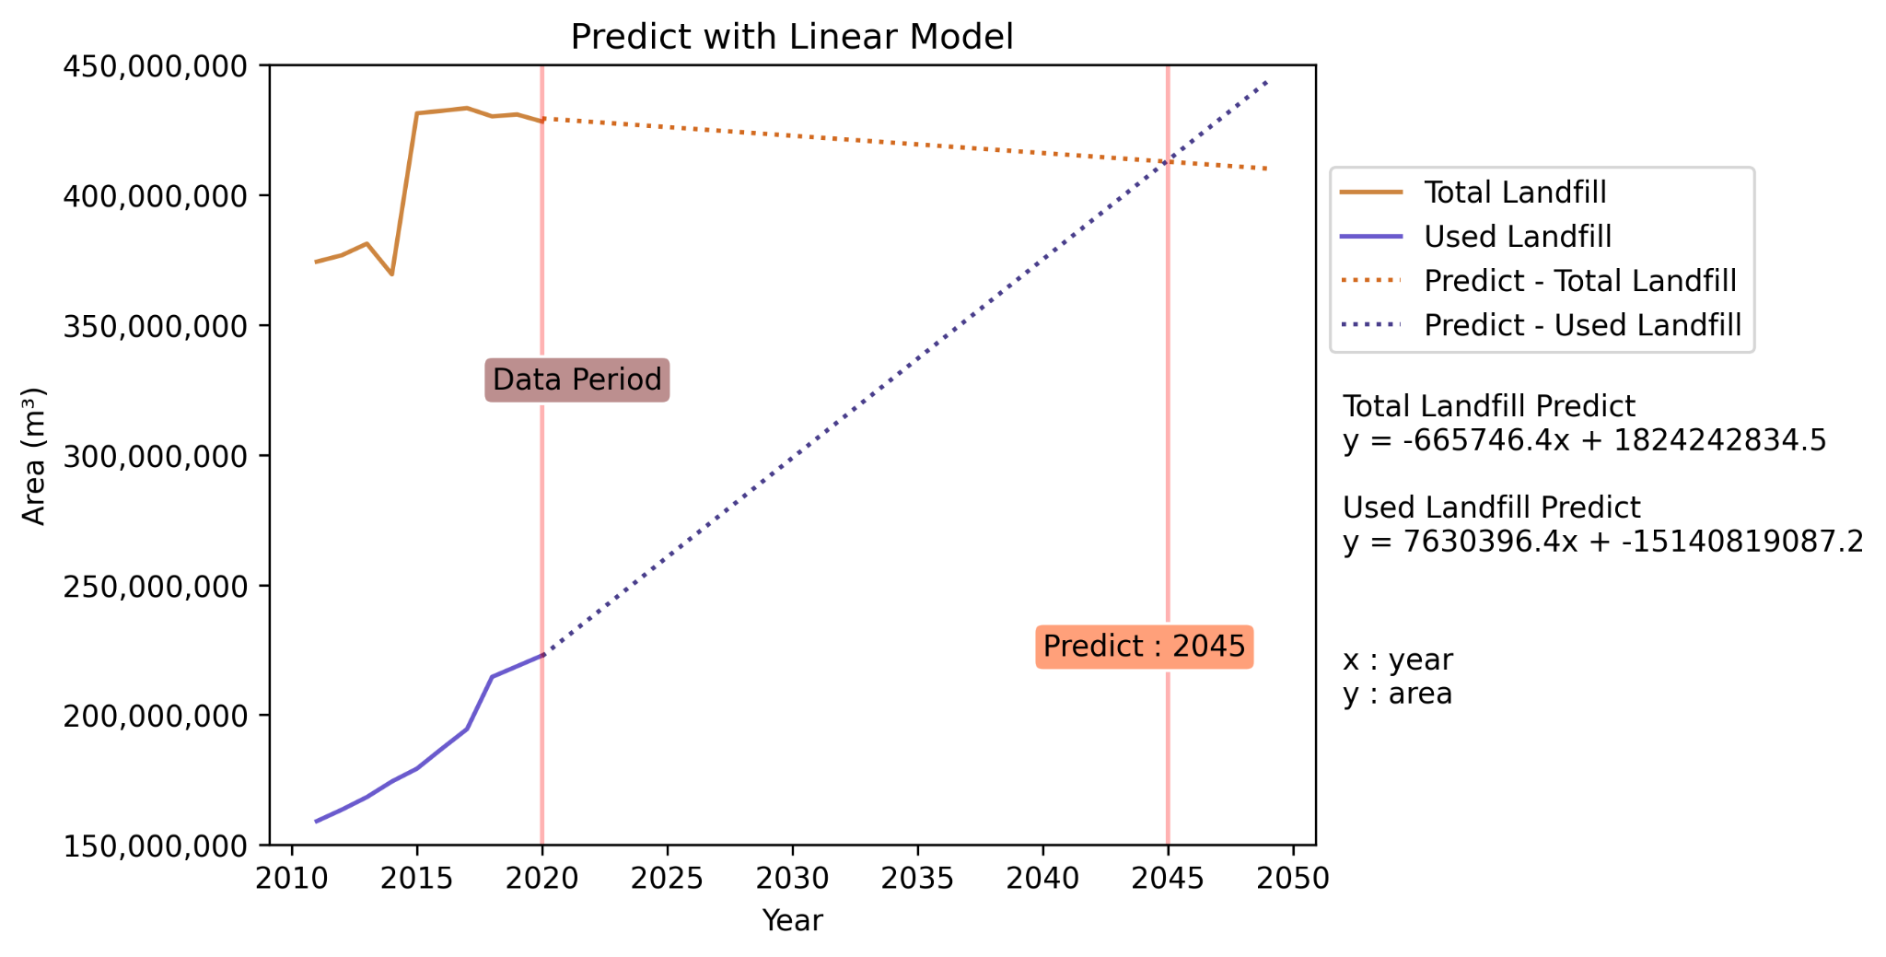
What will happen at Garbage Landfills
in the future?

Slide 14
Then, if they are disposed well…?
김 이서. (2019, December). 플라스틱 대한민국 - 일회용의 유혹. Greenpeace Korea | 그린피스. Retrieved from https://www.greenpeace.org/

Slide 15
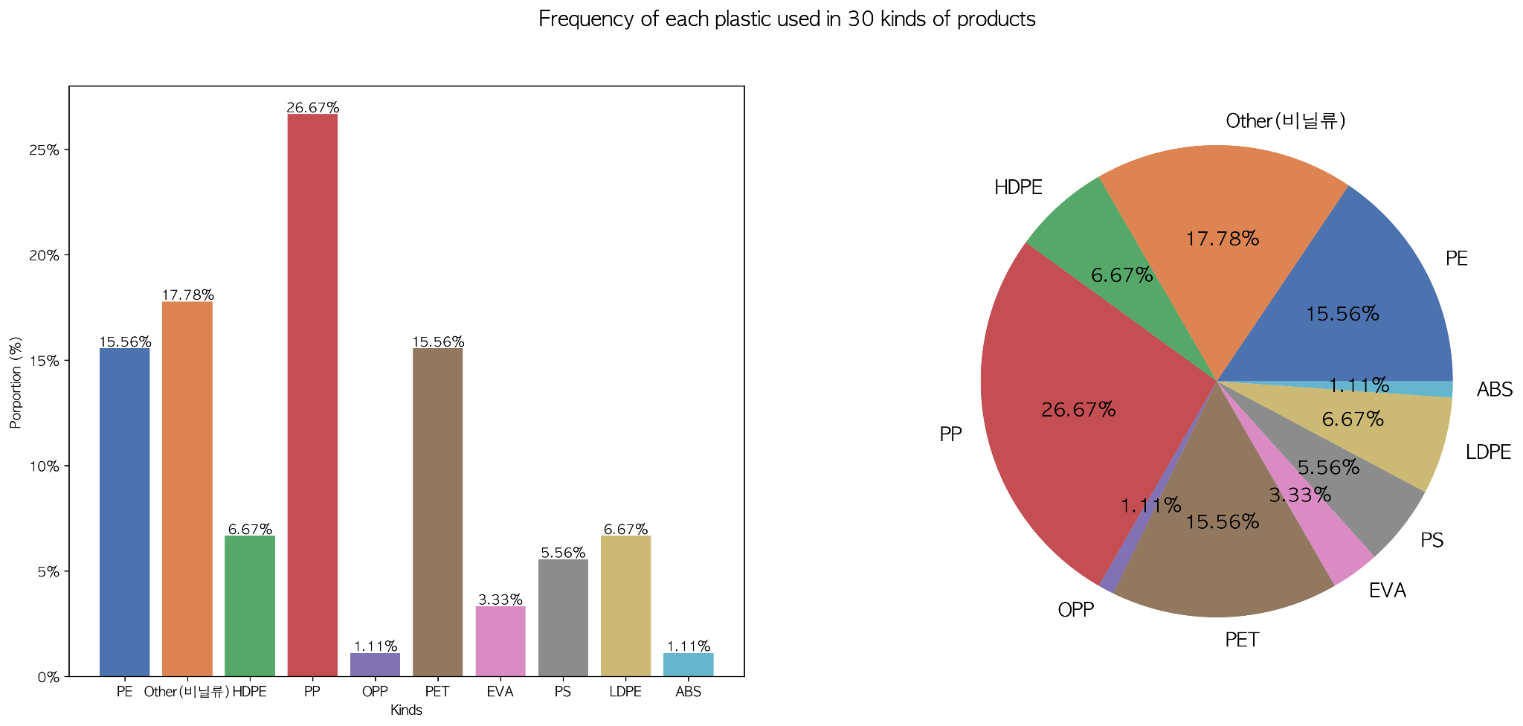
Why can’t we just recycle all plastic?
김 이서. (2019, December). 플라스틱 대한민국 - 일회용의 유혹. Greenpeace Korea | 그린피스. Retrieved from https://www.greenpeace.org/

Slide 16
Oh, then we can burn them!
김 이서. (2019, December). 플라스틱 대한민국 - 일회용의 유혹. Greenpeace Korea | 그린피스. Retrieved from https://www.greenpeace.org/

Slide 17
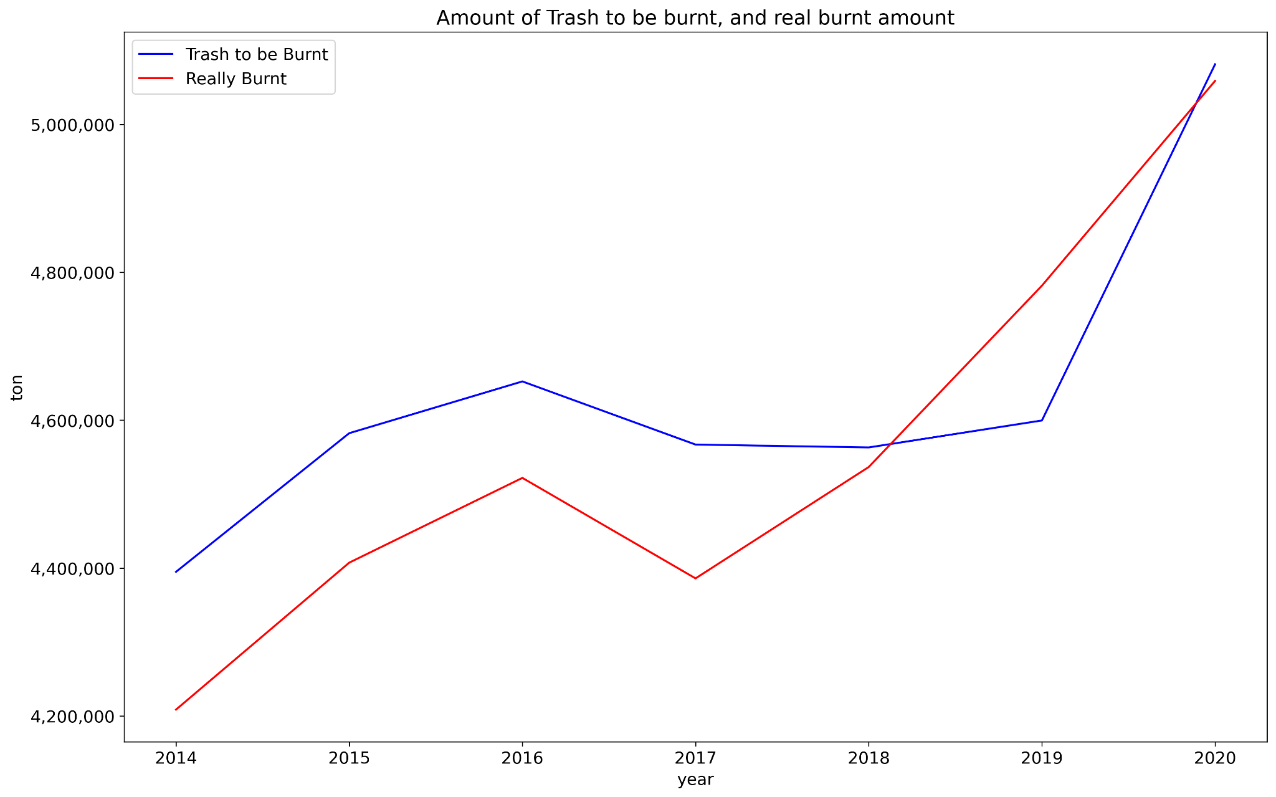
Is it possible to burn all of them?
환경부,「전국폐기물발생및처리현황」, 2020, 2022.12.14, 지방자치단체 폐기물 처리시설 현황_소각시설

Slide 18
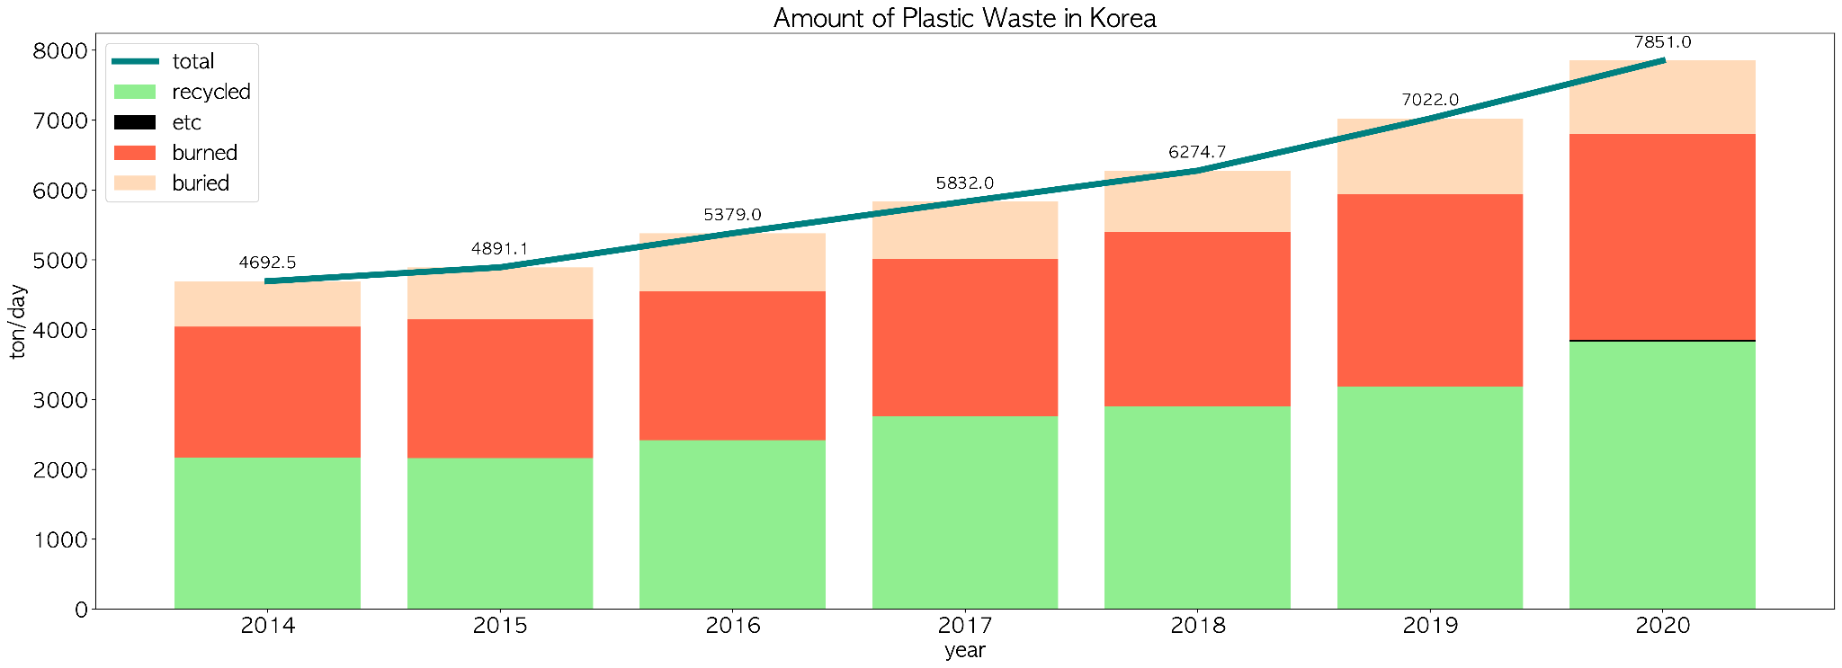
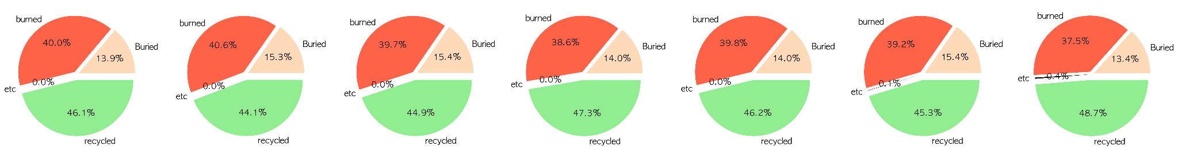
Amount of Plastic Waste in Korea
환경부,「전국폐기물발생및처리현황」 폐기물 발생현황_생활폐기물

Slide 19
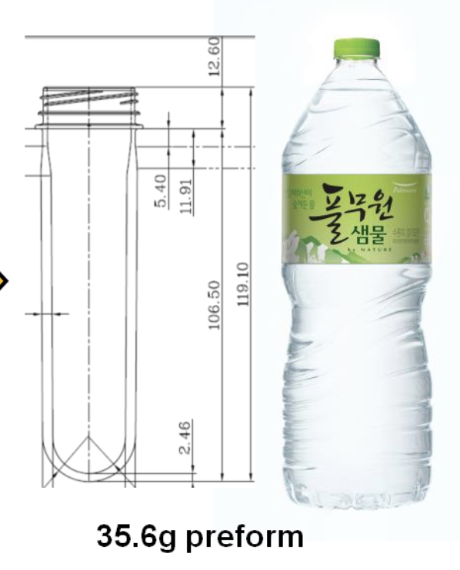
Amount of Plastic Waste in Korea
2020 : 7851 ton/day
Which means… we can make 2L pet…
× 233,967,312…… per day

Slide 20
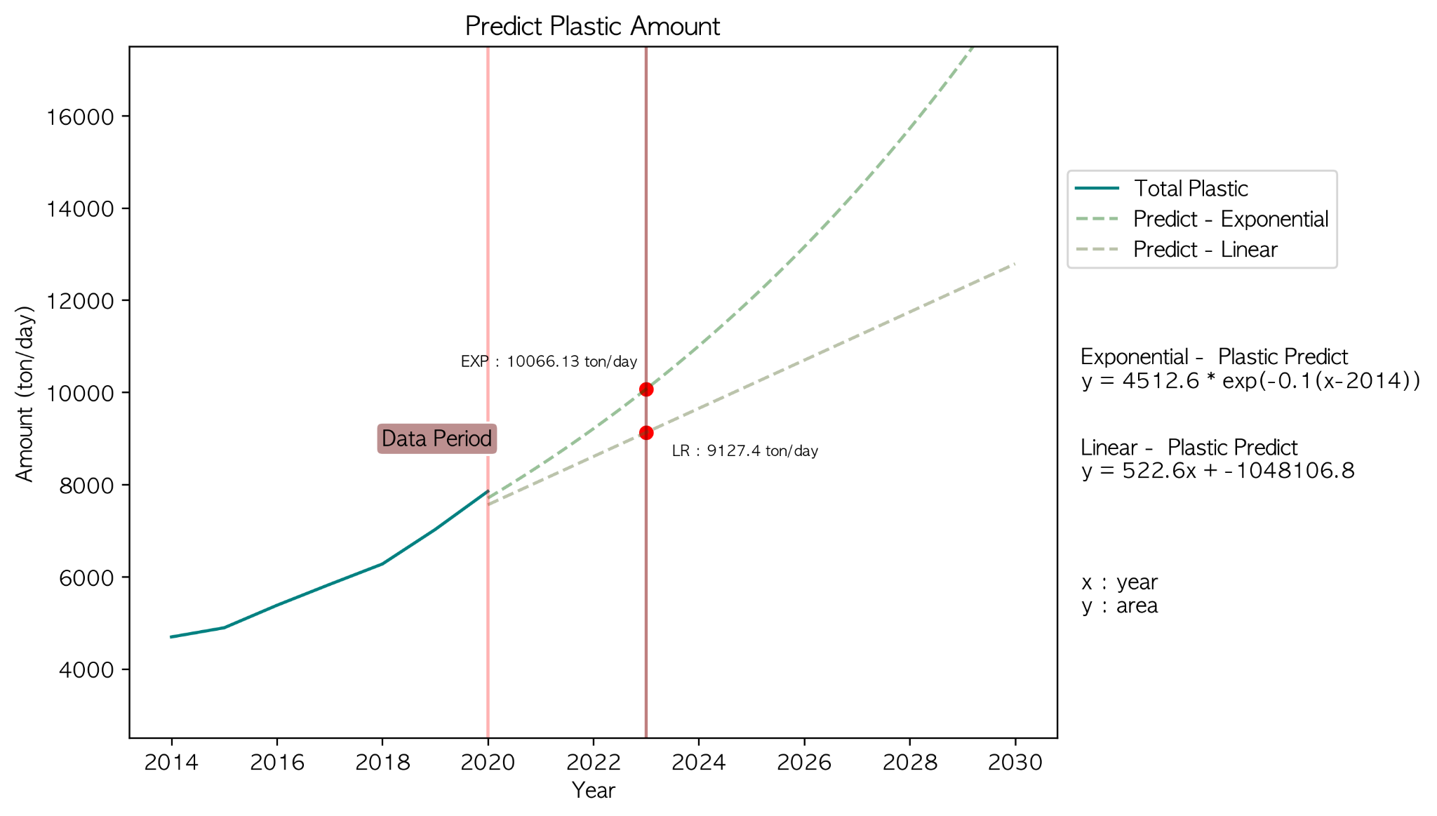
Future of Plastics….

Slide 21
Our Proposal :
We need to reduce amount of non-recyclable plastics,
Not only at consumers’ step,
But also at MANUFACTURERS’ STEP!

Slide 22
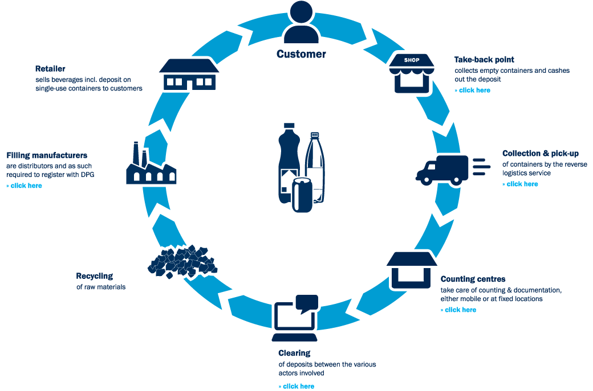
Deposit Return System (DRS)
Source: Economia (2020)

Slide 23
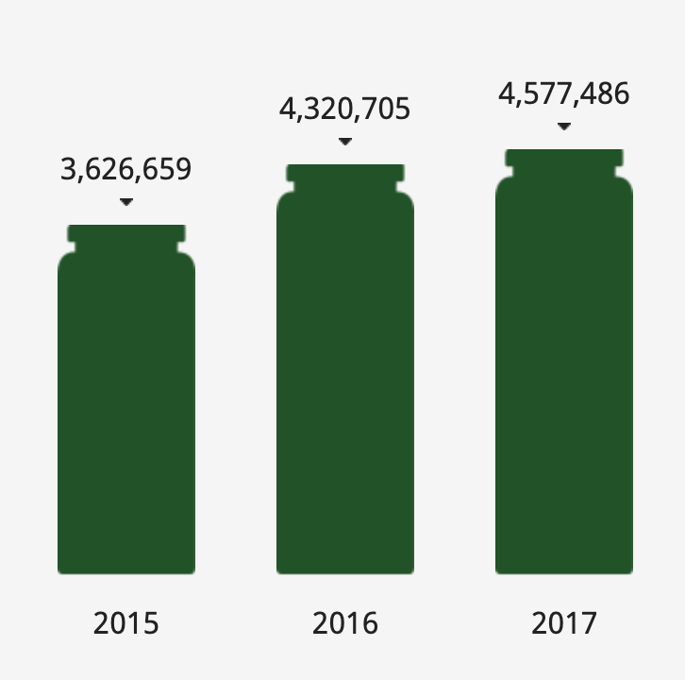
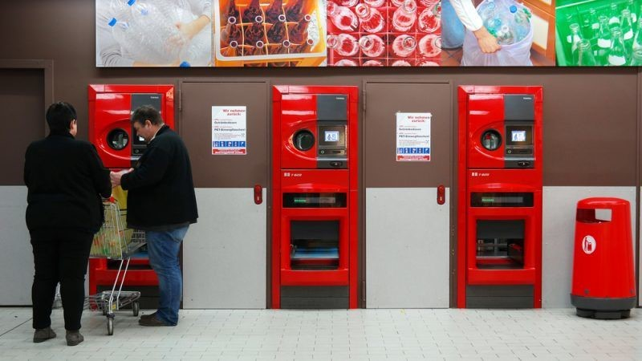
In Practice
Germany
Innisfree
Source: EURACTIV
Source: innisfree Korea

Slide 24
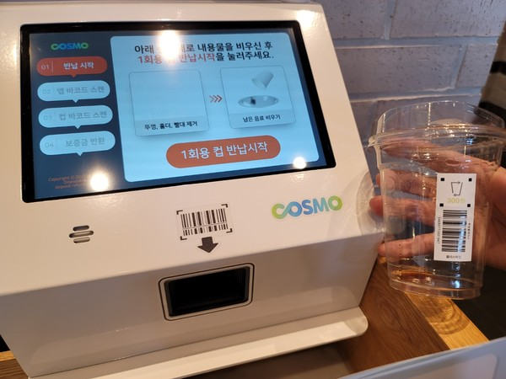
Target
Source: aflnews

Slide 25
June 2022 December 2022 December 2022
Nationally Nationally Jeju & Sejong

Slide 26
Currently
DRS (Deposit Return System)
A small amount of cafes were the target.
Collection box was only in the cafe.
Returnable only at the store where you purchase it.
There is no legal basis.
A less deposit.
A small amount of cafes are the target.
Collection box in the cafe & outside.
Establish Container Deposit System Management Organization(COSMO).
An increased deposit.

Slide 27
Extended Producer Responsibility (EPR)
Extended Producer Responsibility is a policy tool that makes producers legally and financially responsible for mitigating the environmental impacts of their products and packaging.
Without EPR
Producers bear no responsibility for the waste created by the products they make and profit from
With EPR
Producers are required to be responsible for waste recovery and recycling
Source: Upstream

Slide 28
Currently
EPR (Extended Producer Responsibility)
Small amount of plastic applied.
Many types of plastic in total.
Companies not subject to regulation.
Disposable cups are not the target.

Slide 29
Solution
Complement the DRS + EPR
Put collection box outside the cafe.
Every cafe participates in DRS -> all become collection points.
Add a disposable cup of cafe in EPR.
Plastic type unification.

Slide 30
Intended Outcomes
problems
solved
Small amount of cafes
Responsibility of plastic cups
Hygiene problem in cafe
Crowded cafe
Cost of collection box
Every cafe is collection point
EPR
Collection box located outside
Collection box located outside
Government

Slide 31
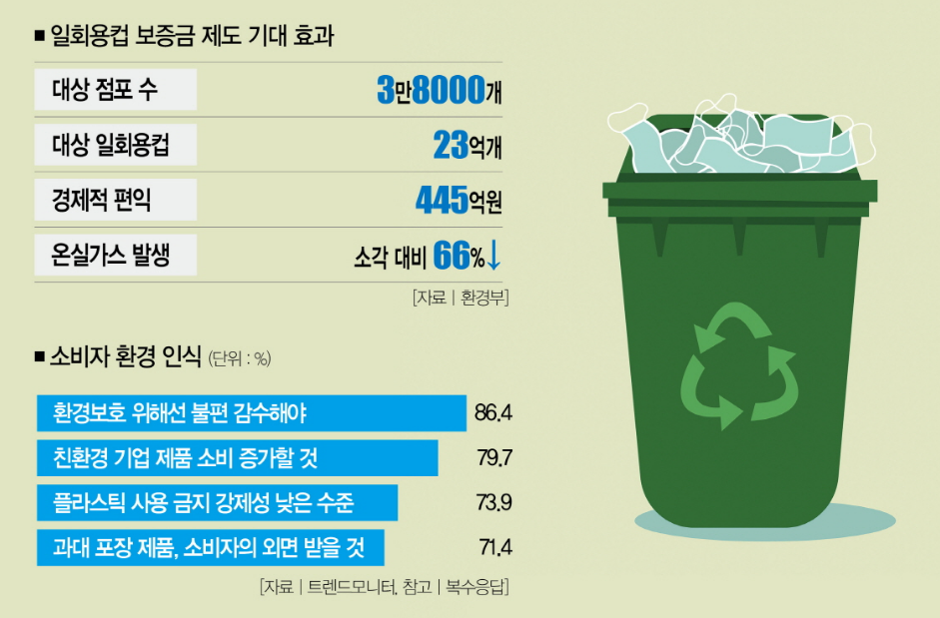
People’s perception
Source:thescoop

Slide 32
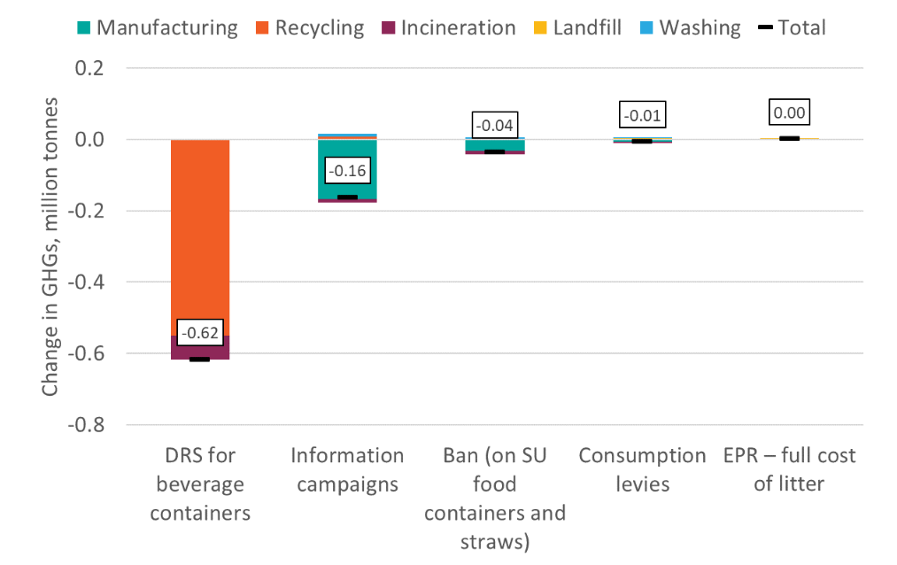
Impact on GHG Emissions (2030 model)
Source: Eunomia Research & Consulting

Slide 33
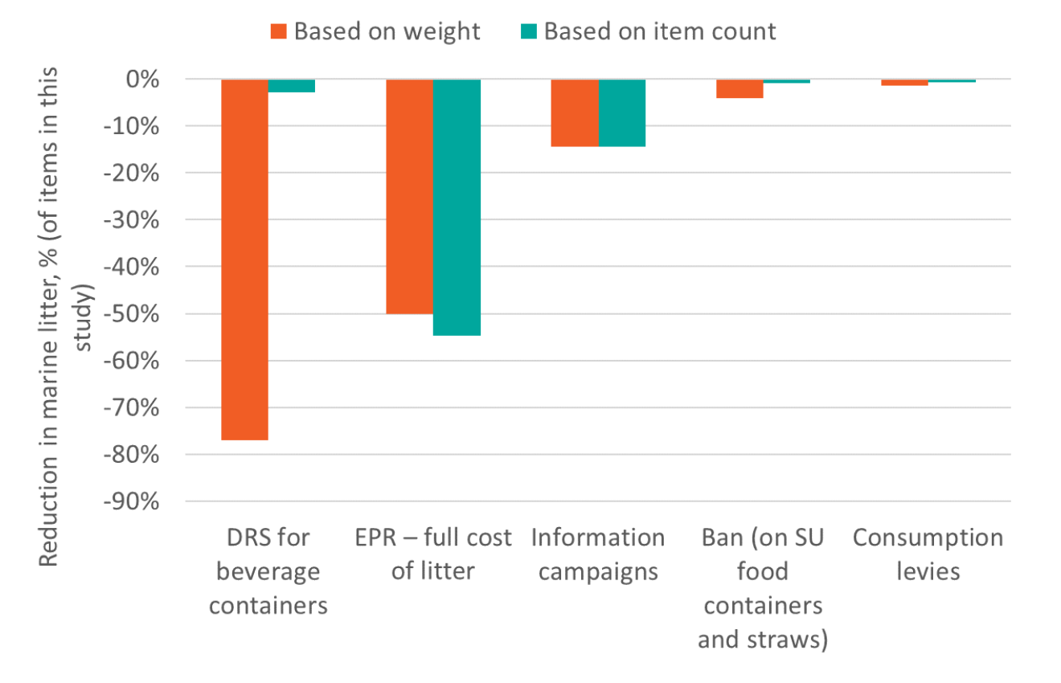
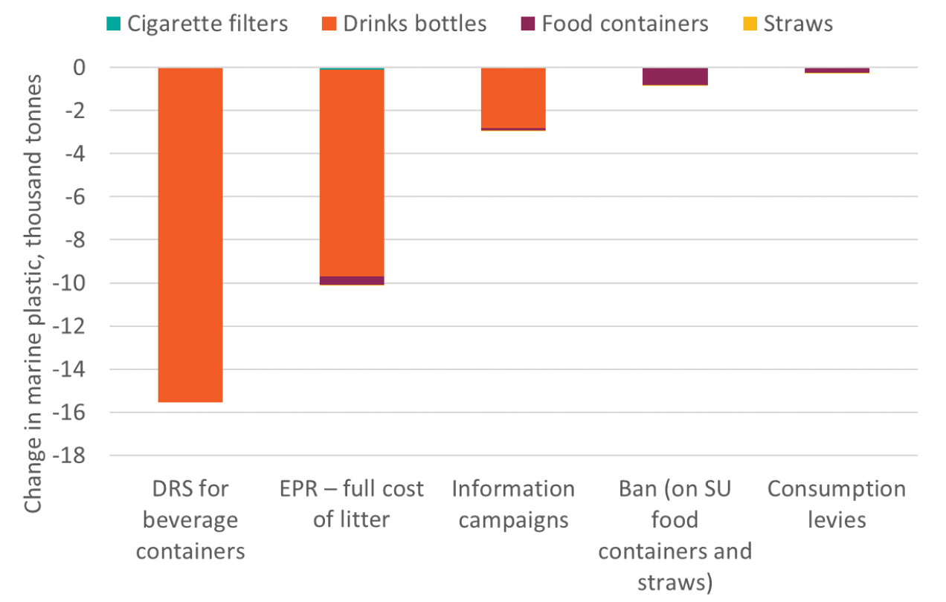
Impact on Marine Litter (2030 model)
Source: Eunomia Research & Consulting

Slide 34

NORWAY
DRS
EPR
RESULT: 95% return rate
Since 1999, a national deposit and recycling system for non-refillable plastic beverage bottles and cans has been operated by Infinitum.
Infinitum is a non-profit organization owned by Norwegian bottlers and retailers.
The Norwegian Government imposes a tax.
Industry collectively decided that the most cost-effective option was to establish a DRS.
Producers who are part of the scheme must report to Infinitum every month. Those producers who do not sign up to the Infinitum scheme pay a fixed environmental fee.

Slide 35
Conclusion
Based on our research, we believe that reducing the number of non-recyclable plastics produced can contribute significantly to solving the resource problem. We suggest implementing a DRS+EPR system in order to get local food packaging producers on board.

Slide 36
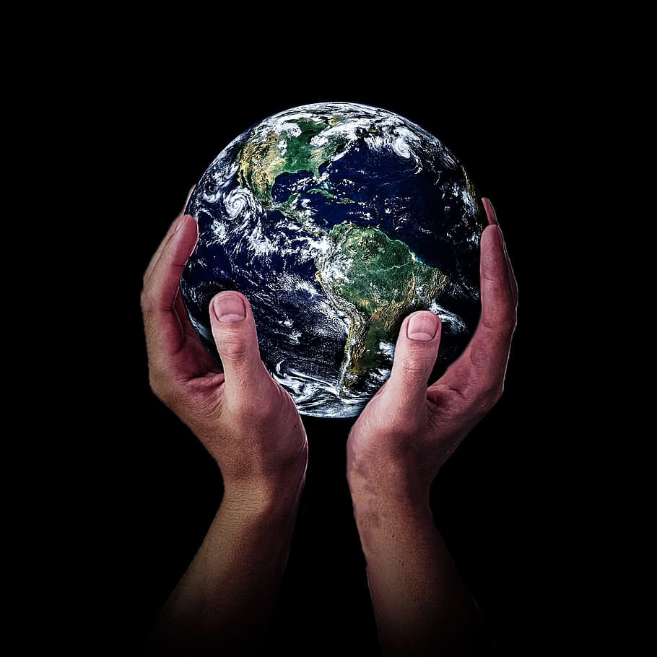
THANK
YOU! :)

